Slide 1
Part One
Step – by – Step Guide to
Creating Your Nonprofit Organization

Slide 2
About the Speaker
Annette Russ is retired CPA from Chico, CA and joined SCORE as a mentor in 2020. She previously owned and operated her own accounting firm, specializing in mentoring small business clients, accounting for a wide variety of businesses and doing tax preparation.
In 2008, along with colleagues in Kenya, Annette founded a small nonprofit whose mission it was to educate rural girls academically and to teach them the life skills they would need to successfully create their own path our of poverty.

Slide 3
What is a Nonprofit?
A nonprofit organization is not operating primarily to make a profit. Instead, it’s an organization whose mission focuses on the public good by furthering a social cause.
Nonprofits are corporations that have been given tax-exempt status , under IRS Code Section 501(c)(3) because it furthers a religious, scientific, charitable, educational, literary, public safety or cruelty-prevention mission or area of work.

Slide 4
Not-for-Profit Organizations
A Not-for-Profit Organization serves only the interest of its members
Section 501(c)(4): civic leagues and social welfare organizations, homeowners' associations, and volunteer fire companies.
Section 501(c)(5): such as labor unions
Section 501(c)(6): such as chambers of commerce.
Section 501(c)(7): such as Social and Recreational Clubs
Section 501(k): childcare-related organizations.

Slide 5
Nonprofit mission statement
Heifer International works with communities to increase income, improve child nutrition, care for the Earth, and ultimately end world hunger and poverty.
Not–for-Profit Organization Mission Statement
As the voice of local business, the Chico Chamber of Commerce, through its Legislative Action Committee, advocates on behalf of businesses regarding local and state legislation, ordinances, and regulations.

Slide 6
The Nuts and Bolts of Starting a Non-Profit
It’s a 2 – Step Process
Incorporate your business
Qualify for tax exempt status

Slide 7
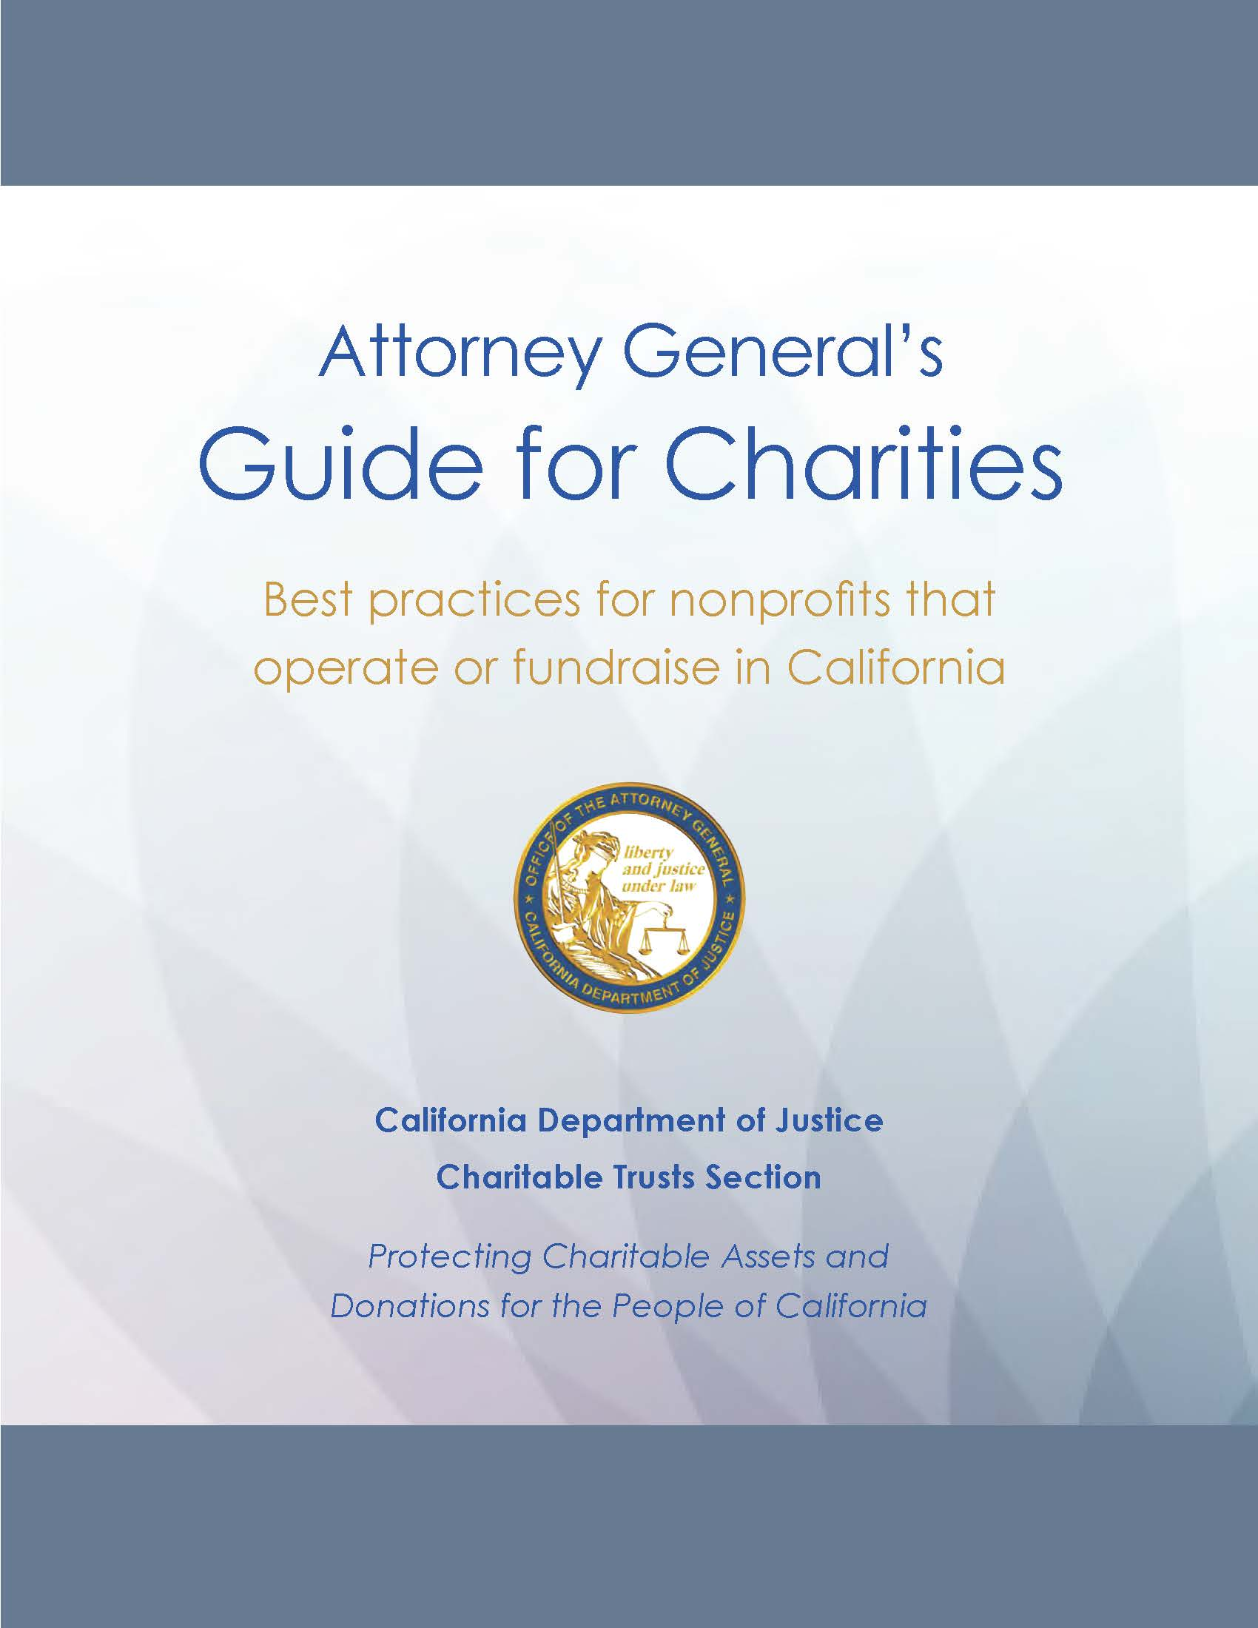
A good place to start is here

Slide 8
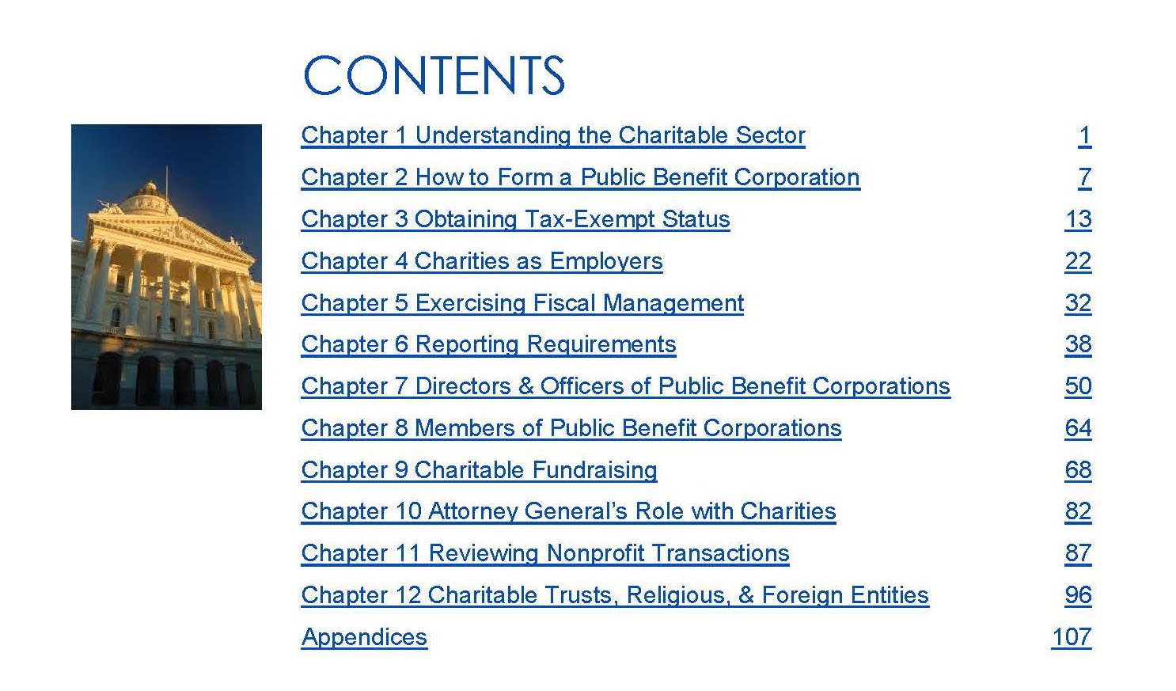
But Wait!

Slide 9
Search Your Name’s Availability

Slide 10
Form a Corporation
Choose your board of directors or nonprofit board
Create and sign your nonprofit corporation’s articles of incorporation
Write your nonprofit corporation's bylaws

Slide 12
File Required Forms
File your nonprofit corporation's articles of incorporation with California Secretary of State and pay any related fees.
ARTS-B-P
File your semiannual Statement of Information with California Secretary of State
SI 550
Register with the California Registry of Charitable of Trusts
Apply for Federal Identification number
If you have employees, apply for a California State Employer ID number

Slide 13
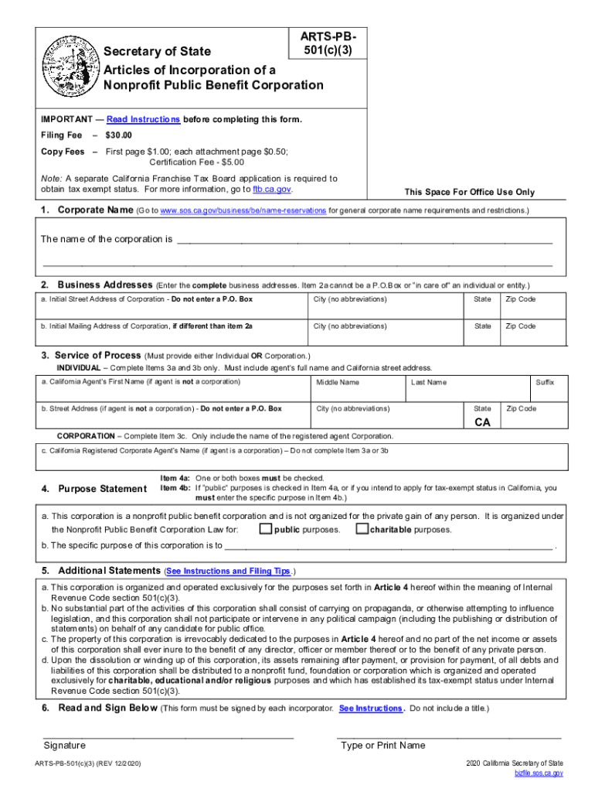

Slide 14
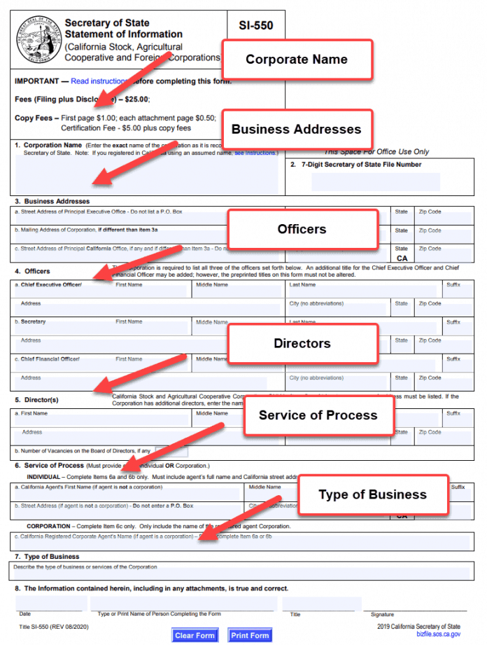

Slide 15
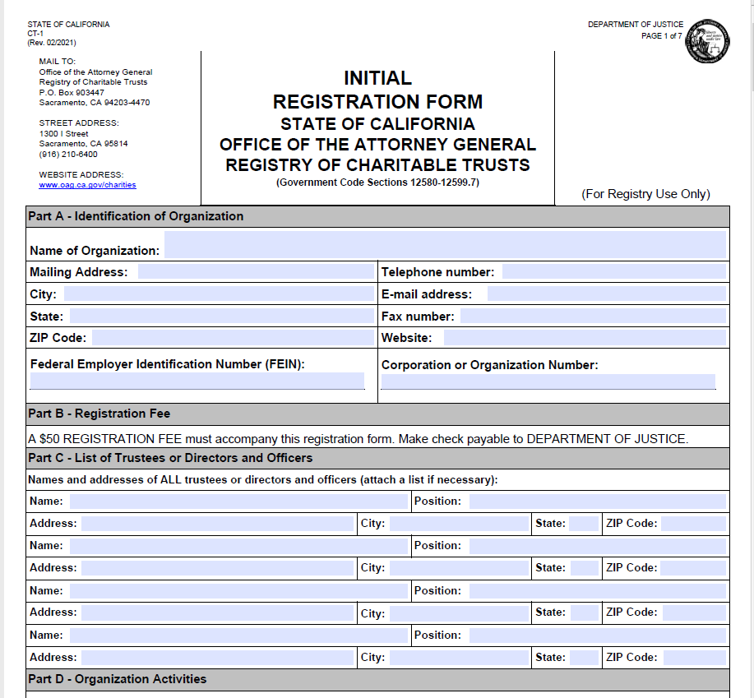

Slide 16
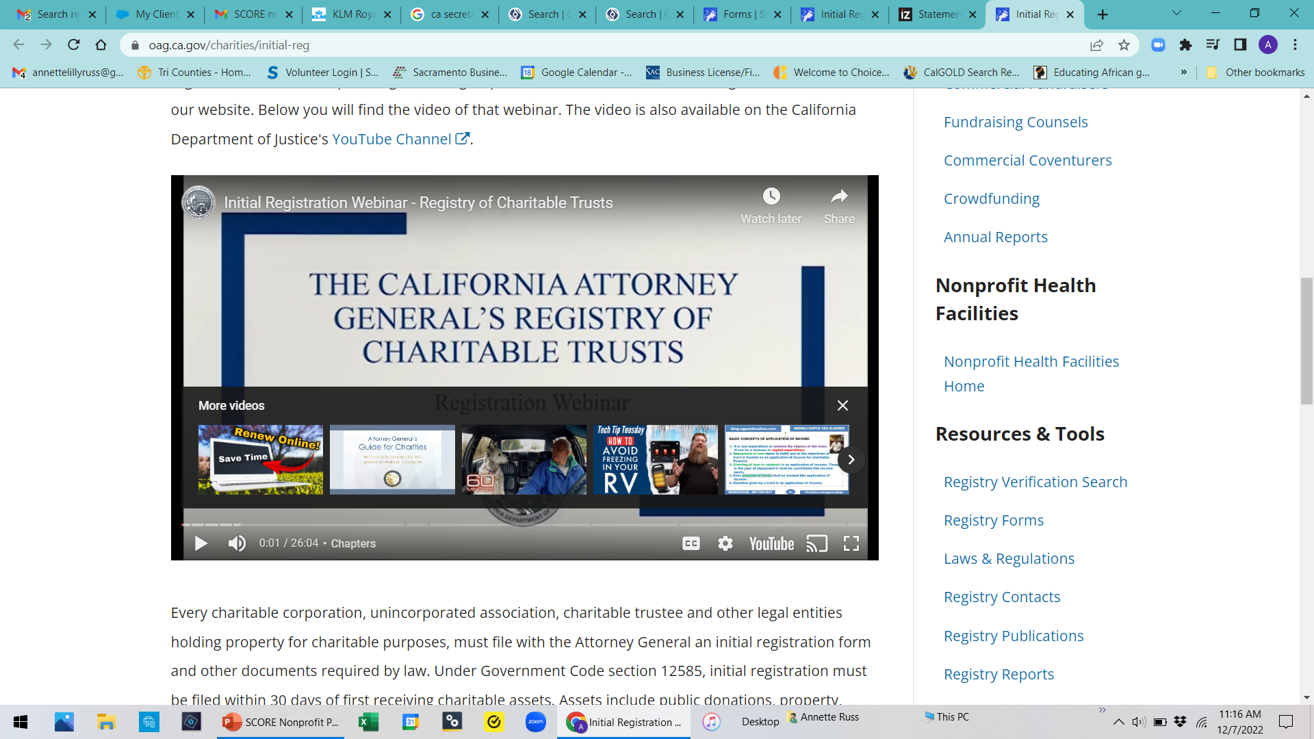

Slide 17
Apply
Apply for IRS 501(c)(3) and California Exempt Status.

Slide 18
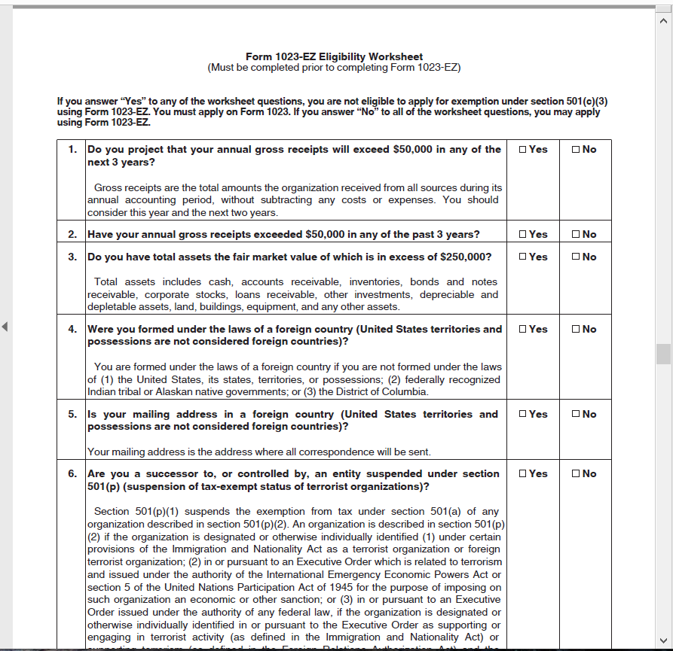

Slide 19
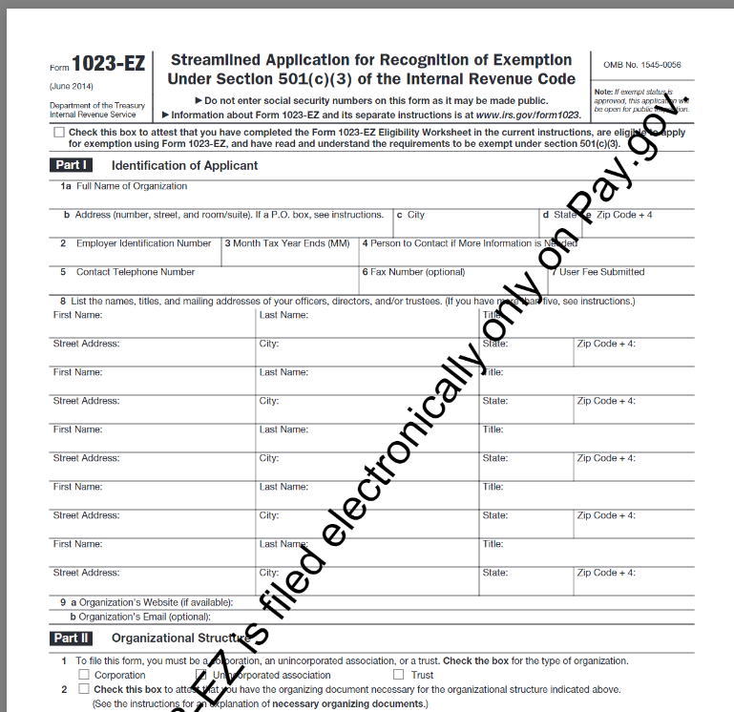

Slide 20
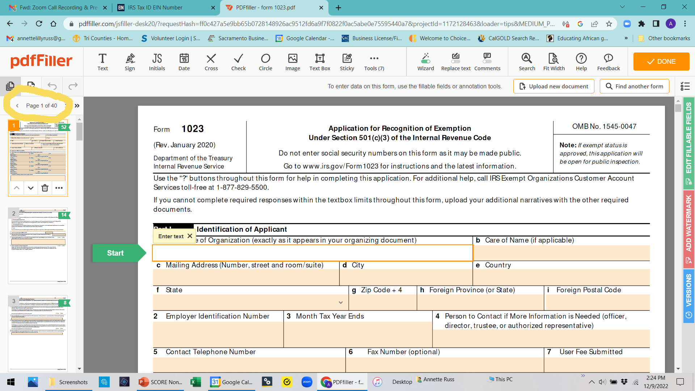

Slide 21
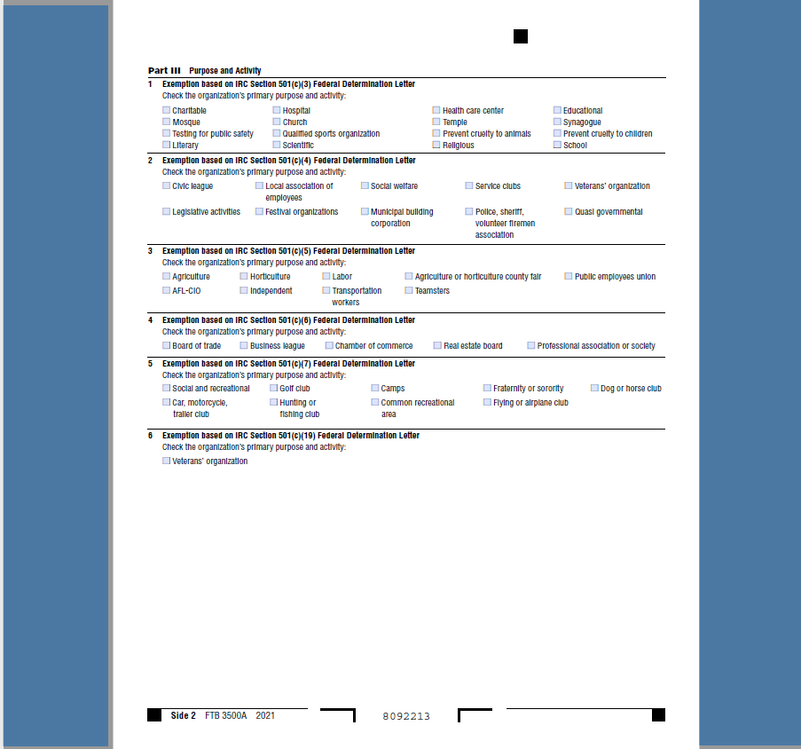

Slide 22
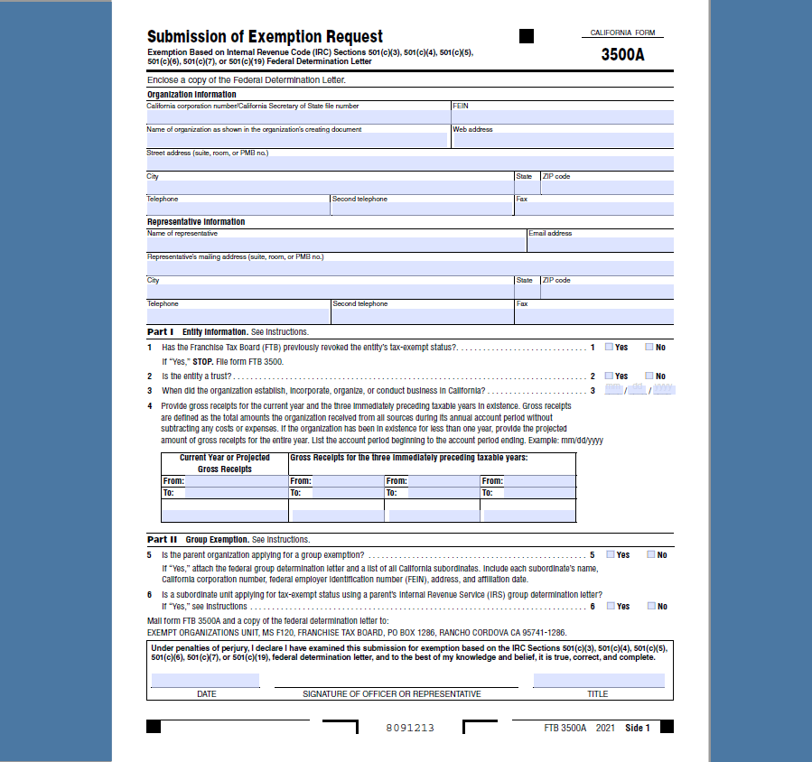

Slide 24
Open a separate nonprofit bank account
Whew! What’s left?
Some of the documents you’ll need to take to the bank
If you are president of the Board, a copy of your social security card and/or driver’s license
Copy of your Federal EIN verification letter
Copies of Articles of Incorporation and list of Board of Directors
Copy of IRS determination letter

Slide 25
Some Miscellaneous Forms
If you have employees…. File for a California employer identification number
*California Employment Development Department*
If you sell merchandise…Apply for a California Sellers Permit
*California Department of Tax and Fee Administration*

Slide 26
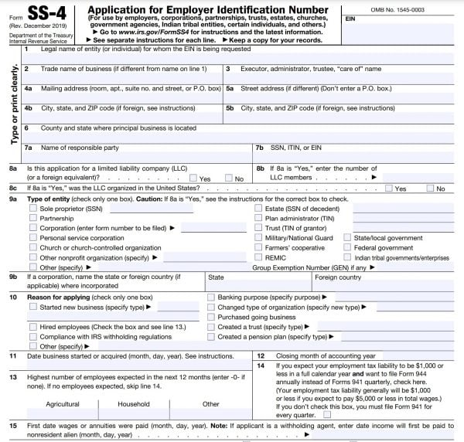

Slide 27
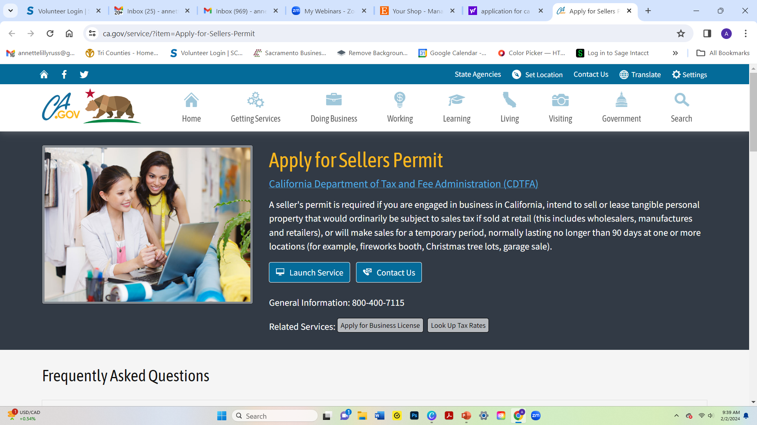

Slide 28
Annual Tax Returns
Payroll Tax Returns(Quarterly and Annually
Sales and Use Tax Returns
Federal Income Tax Return
Form 990N
Form 990EZ
Form 990
California State Tax Returns
Form 199N
Form 199

Slide 29
Part 2 The Nuts and Bolts of Operating Your Nonprofit
Before you start, do your research
Choose a board of directors
Define your mission
Write a business plan
Create a fundraising campaign
All about grant funding
Nonprofit resources

